Slide 3
Selection of design variables :

Slide 11
Modelling :

Slide 14
N.L.P for optimum spring design :

Slide 15
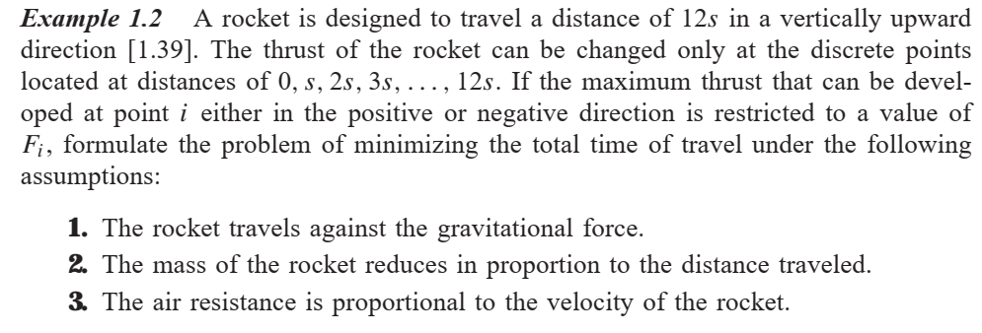

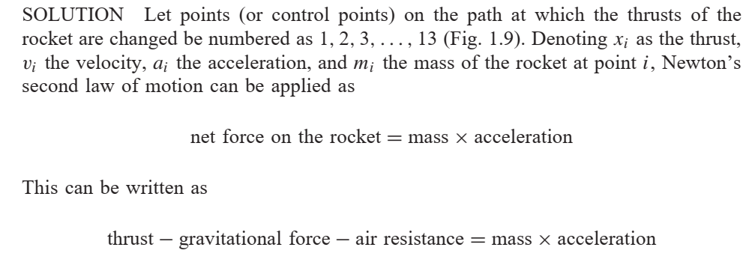

Slide 16
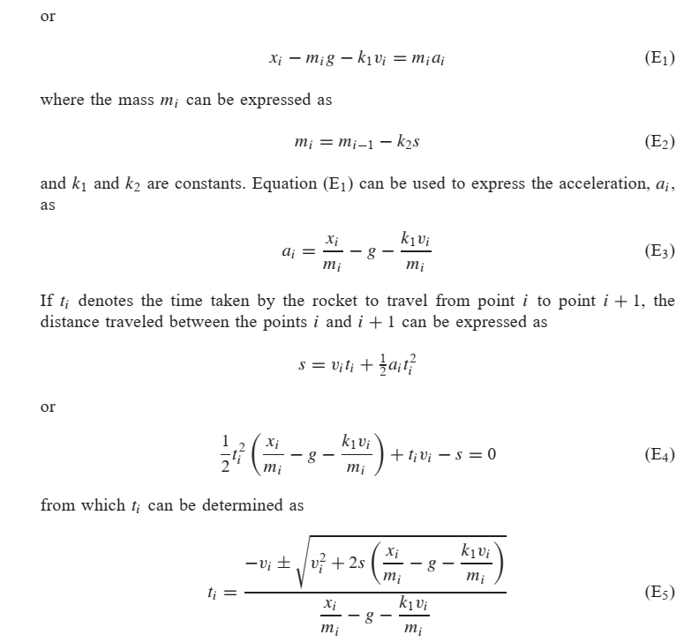

Slide 17
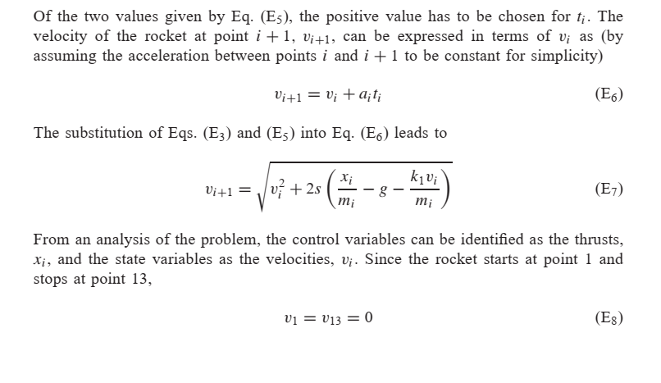

Slide 18
